Slide 1


Constituency Connect
Group Members:
Muhammad Ahsan 21-ARID-737
Haseeb Ur Rehman 21-ARID-715
Huzaifa Bin Shahzad 21-ARID-719
Supervised By:
Ms. Farkhanda Qamar
UNIVERSITY INSTITUTE OF INFORMATION TECHNOLOGY

Slide 2
Table of Contents
Introduction
Literature Review
Benchmarking
Problem Statement
Proposed Model/Solution
Scope
Tools and Technologies (Market Based)
Final Outcome

Slide 3
Introduction
Prepare at-least two (2) slides to briefly describe your project idea.
Properly reference [1] previously used tools and technologies.
If your FYP is related to research oriented properly add references of the paper [2].

Slide 4
Introduction
Constituency Connect is a web-based application designed to improve communication between constituents (citizens) and their elected representatives.
The platform enables users to report complaints, participate in surveys, track performance, and engage with representatives through real-time updates and virtual meetups.
Core Idea:
Provide a seamless, transparent, and efficient channel for citizens to voice their concerns, track issues, and hold representatives accountable for actions and resolutions.

Slide 5
Introduction
Key Features:
Complaint Reporting: Allows users to file complaints and track progress.
Performance Tracking: Track the performance of representatives with data visualizations.
Real-Time Updates: Stay informed with live updates on complaint statuses, event notifications, etc.
Virtual Meetups: Enable citizens to engage in video conferencing sessions with representatives.
Surveys and Polls: Gather feedback on public issues through interactive surveys and polls.

Slide 6
Literature Review
Prepare at-least five (5) slides and develop a base for your project starting from initial technology/research.
Properly reference previously used tools and technologies [3].

Slide 7
Literature Review
K

Slide 8
Literature Review
K

Slide 9
Literature Review
K

Slide 10
Literature Review
K

Slide 11
Literature Review
K

Slide 12
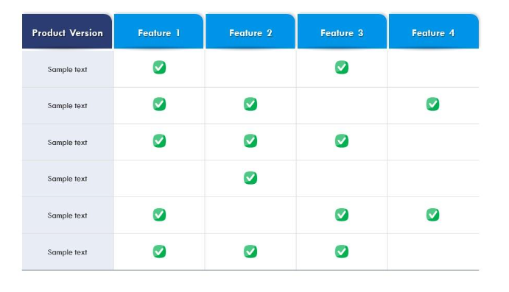
Benchmarking
Once you cover basic understanding of problem, now you will map them in the form of a table to narrow down your problem.

Slide 13
Problem Statement
Define your problem in one paragraph keep in mind your literature review limitations and the gaps identified in the benchmarking table.

Slide 14
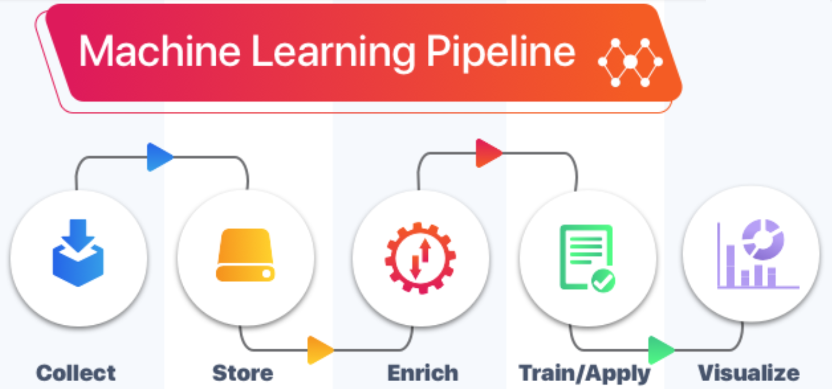
Proposed Model
Write down abstract idea of your project, and add its model diagram

Slide 15
Scope of your Project
Properly write the scope of your project. Avoid general solutions.

Slide 16
Tools and Technologies (Market Base)
List down tools and technologies, you want to use for development purposes. Avoid old ones, explore market oriented tools and technologies.

Slide 17
Final Outcome
Describe shortly the nature of your project outcome.
Whether it’s a Advance Technology/ Product / Framework/ Solution to the existing Problem or a novel research, etc.

Slide 18
References
www.deeplearning.ai (Last visit date 13-09-2024)
M. Habib, A. Hussain, S. Rasheed, M. Ali, Adaptive fuzzy inference system based directional median filter for impulse noise removal, AEU - International Journal of Electronics and Communications, 70 (5), 2016, 689-697, https://doi.org/10.1016/j.aeue.2016.02.005.
…

Slide 19


